Slide 1
Lecture 4 Linear Programming Max Flows + Sensitivity Analysis

Slide 2
Warm Up

Slide 3
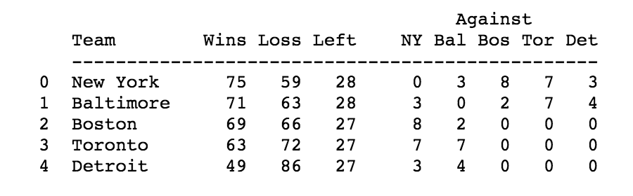
Baseball Elimination Problem
Can Detroit Still Win the Division? We can answer this question using Max Flow!

Slide 4
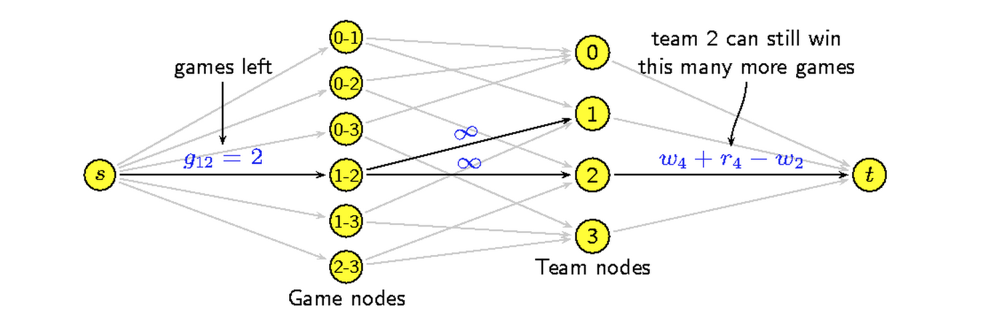
Baseball Elimination Problem

Slide 5
Introduction – Sensitivity Analysis
In general, we are never content with only the optimal solution to a linear program and want to acquire insight into the economics of the situation we are modeling
For example, we may want to know how sensitive our solution is to changes in the objective function or changes in some of the constraints. (Why?)
Frequently, firms may want to invest in order to alleviate constraints: how exactly should a potential investment be allocated
Sensitivity analysis is vital to the intelligent use of any optimal LP solution

Slide 6
Introduction
The first part of the lecture gives an “operational overview” of the most important concepts in sensitivity analysis.
In the first part, we’ll learn “how to” using Excel output
Then we’ll try to dig deeper and explore some of the “why” questions
For example, we’ll learn that sensitivity analysis offers a unique insight into the properties of the optimal solution of any linear program

Slide 7
What is Sensitivity Analysis?
The study of how changes in the parameters of a linear program
affect the optimal solution (x_{i}*) and the optimal objective function value
Objective (OBJ) function:
Change in coefficients
MAX(MIN) c₁ x₁ + c₂ x₂ + c₃ x₃ + …. c_{n} x_{n}
ST:
A₁₁ x₁ + A₁₂ x₂ + A₁₃ x₃ + …. A_{1n} x_{n} ≤ (≥) B₁
A₂₁ x₁ + A₂₂ x₂ + A₂₃ x₃ + …. A_{2n} x_{n} ≤ (≥) B₂
A₃₁ x₁ + A₃₂ x₂ + A₃₃ x₃ + …. A_{3n} x_{n} ≤ (≥) B₃
………
………
A_{m1} x₁ + A_{m2} x₂ + A_{m3} x₃ + …. A_{mn} x_{n} ≤ (≥) B_{m}
x_{i}'s ≥ 0 or unrestricted in sign
Constraints:
Change in RHS
constants

Slide 8
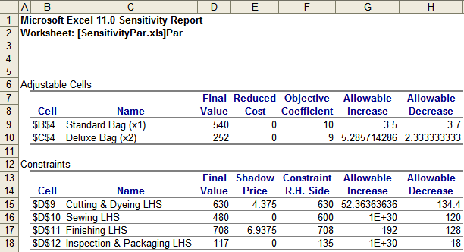
Sensitivity Report in Excel
Profit Contribution Maximize 10 x₁ + 9 x₂
Subject to:
Cutting & Dyeing: 7/10 x₁ + x₂ ≤ 630
Sewing: 1/2 x₁ + 5/6 x₂ ≤ 600
Finishing: x₁ + 2/3 x₂ ≤ 708
Inspection & Packaging: 1/10 x₁ + 1/4 x₂ ≤ 135
Non-negative: x₁ ≥ 0 , x₂ ≥ 0
Optimal Solution: x₁=540, x₂=252
Optimal profit: 10*540+9*252
=7668
Sensitivity Report
OBJ function related analysis
Constraints related analysis

Slide 9
Agenda
Example: Par Inc
Objective function: Change in coefficient
“allowable increase” and “allowable decrease”
“reduced cost”
Constraints: Change in right-hand-side constants
“shadow price”
“allowable increase” and “allowable decrease”
Simultaneous changes
“100% rule”
Summary

Slide 10
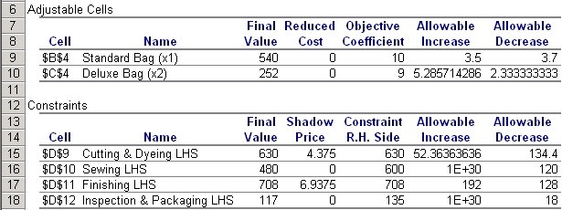
Change in OBJ Function Coefficient
Q1. What if the unit profit of the deluxe bag is $10 instead of $9?
What will happen to the optimal production plan and the optimal profit?
Max 10 x₁ + 9 x₂
Cutting & Dyeing 7/10 x₁ + x₂ ≤ 630
Sewing 1/2 x₁ + 5/6 x₂ ≤ 600
Finishing x₁ + 2/3 x₂ ≤ 708
Inspection & Packaging 1/10 x₁ + 1/4 x₂ ≤ 135
x₁ ≥ 0, x₂ ≥ 0,
10 x₁ + 10 x₂
10 -9 ≤ 5.29 (the allowable increase of the coefficient of x₂ )
=> Solution (540, 252) does NOT change
New profit = old profit + (10-9)×252 = 7668+252=7920

Slide 11
“Allowable Increase” and “Allowable Decrease” in the “Adjustable Cells”
Suppose Let
“Allowable” ranges tell you how much the coefficient of a given decision variable in the objective function may be increased or decreased without changing the optimal solution (the value of the decision variables x_{i}*), where all other data are assumed to be fixed.
Calculate the new Objective Function Value (OV_{new})
When ΔC_{i} is within the “Allowable” range: x_{new}* =x_{old}*
When ΔC_{i} is outside the “Allowable” range: x_{new}* ≠ x_{old}*, re-formulate LP and resolve!

Slide 12
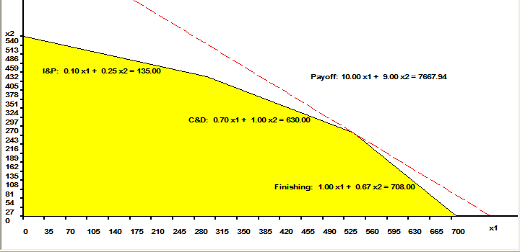
Change in OBJ Function Coefficient – Graphical Interpretation
(540, 252) remains optimal as long as the objective function stays
within the cone formed by the binding constraints
(here finishing and cutting & dyeing are binding constraints)
Iso-profit line
(540,252)

Slide 13
Change in RHS Value of A Constraint – Shadow Price
Q2: What if an additional 10 hours of production time is available in cutting & dyeing?
What will happen to the optimal production plan and the optimal profit?
Max 10 x₁ + 9 x₂
Cutting & Dyeing 7/10 x₁ + x₂ ≤ 630
Sewing 1/2 x₁ + 5/6 x₂ ≤ 600
Finishing x₁ + 2/3 x₂ ≤ 708
Inspection & Packaging 1/10 x₁ + 1/4 x₂ ≤ 135
x₁ ≤ 0, x₂ ≤ 0,
7/10 x₁ + x₂ ≤ 640
640 - 630 = 10 ≤ 52.36 (where 52.36 is the allowable increase of RHS
of C&D constraint) => New profit = Old profit +shadow price×RHS change
= 7668 + 4.375×(640-630) = 7711.75.

Slide 14
Interpretations of Shadow Price
Shadow Price
Is the amount by which the objective function value changes given a unit increase in the RHS value of the constraint
represents the marginal value of resource, its marginal impact on the OBJ value
assuming all other coefficients remain constant
“Allowable Increase” and “Allowable Decrease” in Constraints
“Allowable increase”= increase over which shadow price holds
“Allowable Decrease” = decrease over which shadow price holds
Suppose Let
When ΔB_{j} is within the “Allowable” range : shadow price can be used in the following way
OV_{new} = OV_{old} + shadow price * ΔB_{j}
For binding constraint: optimal solution will be different, re-formulate LP, and re-solve
For non-binding constraint: optimal solution will be the same.
When ΔB_{j} is outside this “Allowable” range: cannot use the shadow price for changes outside the “Allowable” range , re-formulate LP, re-solve.

Slide 15

Effective Range for Shadow Price
Effective range for shadow price is specified by
“Allowable Increase” and “Allowable Decrease” of CONSTRAINTS
Iso-profit line
New Optimal
Solution
New C&D constraint
Old Optimal
Solution
Old C&D constraint

Slide 16
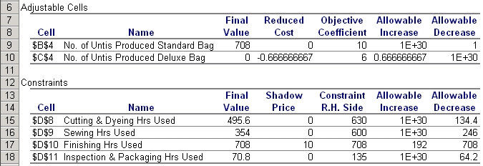
Change in OBJ Function Coefficient - Reduced Cost
Q3. Suppose we have the following golf bag problem:
Max 10 x₁ + 6 x₂
Cutting & Dyeing 7/10 x₁ + x₂ ≤ 630
Sewing 1/2 x₁ + 5/6 x₂ ≤ 600
Finishing x₁ + 2/3 x₂ ≤ 708
Inspection & Packaging 1/10 x₁ + 1/4 x₂ ≤ 135
x₁≤ 0, x₂≤ 0,
=> Optimal solution: (708, 0)
Q3. What minimal unit profit should the deluxe bag generate
in order to have positive production?

Slide 17
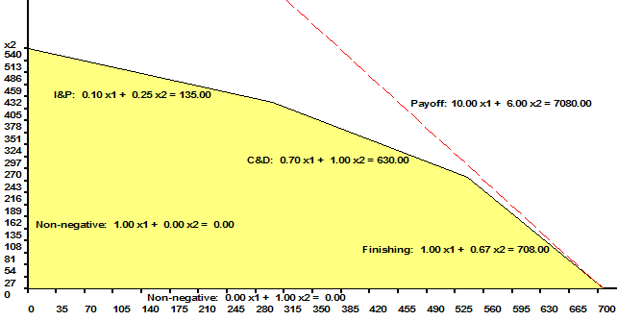
Reduced Cost – Graphical Interpretation
Reduced Cost of a product
= difference between its marginal contribution to the OBJ
function value and the marginal value of the resources it consumes
Producing 1 unit deluxe bag
consumes
Resource hr Shadow price
C&D: 1 0
S: 5/6 0
F: 2/3 10
I&P: ¼ 0_______
The marginal value of the resources it consumes is
1*0+5/6*0 +2/3*10+1/4*0=20/3
The minimum unit profit of deluxe bag
should be 20/3=6.67 = (6+0.67) in order to have positive production.
The current unit profit of deluxe bag
is 6.
Therefore, reduced cost = 6-20/3
= −2/3 = −0.67, i.e., producing 1 unit deluxe bag reduces profit by 0.67.
10 x1 + (20/3) x2 =7080
10 x1 + 6x2 =7080

Slide 18
Simultaneous Changes in Parameters
1. If all changes are in the objective function coefficients, then you can use the 100% rule.
2. If all changes are in the RHS values, then you can use the 100% rule.
3. If changes are in both the objective function and RHS, you must reformulate and re-solve!
4. If unsure, reformulate and re-solve!

Slide 19
100% Rule
For all changes that are made, sum the percentages of increase-changes with respect to (w.r.t.) the corresponding “Allowable Increases” and the percentages of decrease-changes w.r.t. the corresponding “Allowable Decreases,” in absolute values.
2. For simultaneous OBJ coefficient changes,
if the sum of the percentage changes does not exceed 100%, the optimal solution will not change.
3. For simultaneous RHS changes,
if the sum of the percentage changes does not exceed 100%, the shadow prices apply.
4. If the sum of the percentage changes DOES exceed 100%, then reformulate and re-solve!

Slide 20
Simultaneous Changes
Q4. If the unit profit of the standard bag decreases to $8 and the unit of deluxe bag increases to $10, does the current production plan remain optimal?
|10 - 8|/3.7 + |10 -9|/5.29 = 0.7296 < 100%
Production plan remains optimal
New Profit = old profit +(8-10)×540 + (10-9)×252 = $6840

